Slide 1


Serverless Compute
Hugo Melendez
Technical Solution Professional

Slide 2
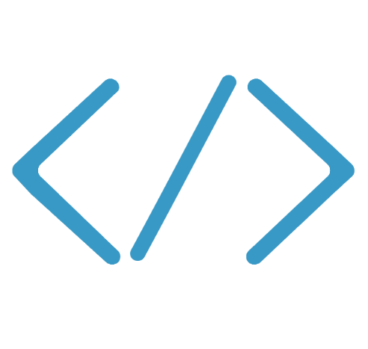

Serverless
Code
Serverless
Events + data
Notes:
Serverless computing is an execution model in which the customer only manages the code, and the vendor manages the allocation of compute resources. It is also known as Functions as a Service, which is actually a better name for it. In Serverless, your code is triggered based on events, and it executes to produce the desired results.

Slide 3
What is Serverless
$
Abstraction of servers
Event-driven/ instant scale
Micro-billing

Slide 4
Why people like Serverless
Manage apps not servers
Reduced DevOps
Faster time to market

Slide 5
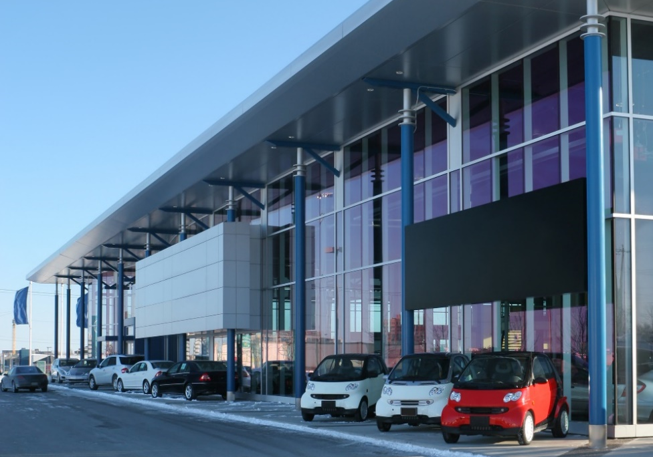


…if cloud computing was transportation
IaaS
PaaS
Serverless
…you can lease a car and take care of maintenance

Slide 6
…if cloud computing was transportation
IaaS
PaaS
Serverless
…you can lease a car and take care of maintenance
…you can rent a car
…you can rent a car and pay for having it around even when you are not driving

Slide 7
…if cloud computing was transportation
IaaS
PaaS
Serverless
…you can lease a car and take care of maintenance
…you can rent a car
…you can use a ride sharing app pay only for transportation
…you can rent a car and pay for having it around even when you are not driving

Slide 8



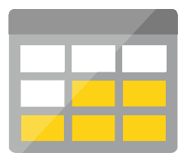
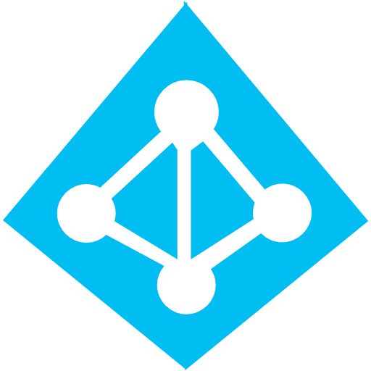



Azure Serverless application platform
Development
Platform
IDE support
Event Grid
Logic Apps
Functions
Manage all events that can trigger code or logic
Design workflows and orchestrate processes
Execute your code based on events you specify
Integrated DevOps
Local Development
Monitoring
Database
Storage
Security
IoT
Analytics
Intelligence
Visual Debug History
Notes:
Talking points:
A solution is not just about compute. It likely includes data, storage, security. And with the Intelligent Edge and Intelligent Cloud, it likely needs AI services as well. And the integration to these services in Azure is first class.
As you would expect from Microsoft, we have a leading Application Lifecycle Management story
Visual Studio and Code to develop and debug locally
Application Insights integration helps you understand how your application is behaving in the wild.

Slide 9
Functions

Slide 10
Introducing Functions
Code
Azure Functions
Events + data

Slide 11
Serverless scenarios: anything that responds to events
Timer-based processing
Real-time stream processing
Every 15 minutes
Find and clean invalid data
Clean table
Millions of devices feed into Stream Analytics
Transform to structured data
Store data in SQL DB
Mobile app backends
Real-time bot messaging
?
...
Photo taken and WebHook called
Stores in blob storage
Produces scaled images
Message sent to Chatbot
Chatbot sends
response
Cortana Analytics answers questions

Slide 12
Logic Apps

Slide 13
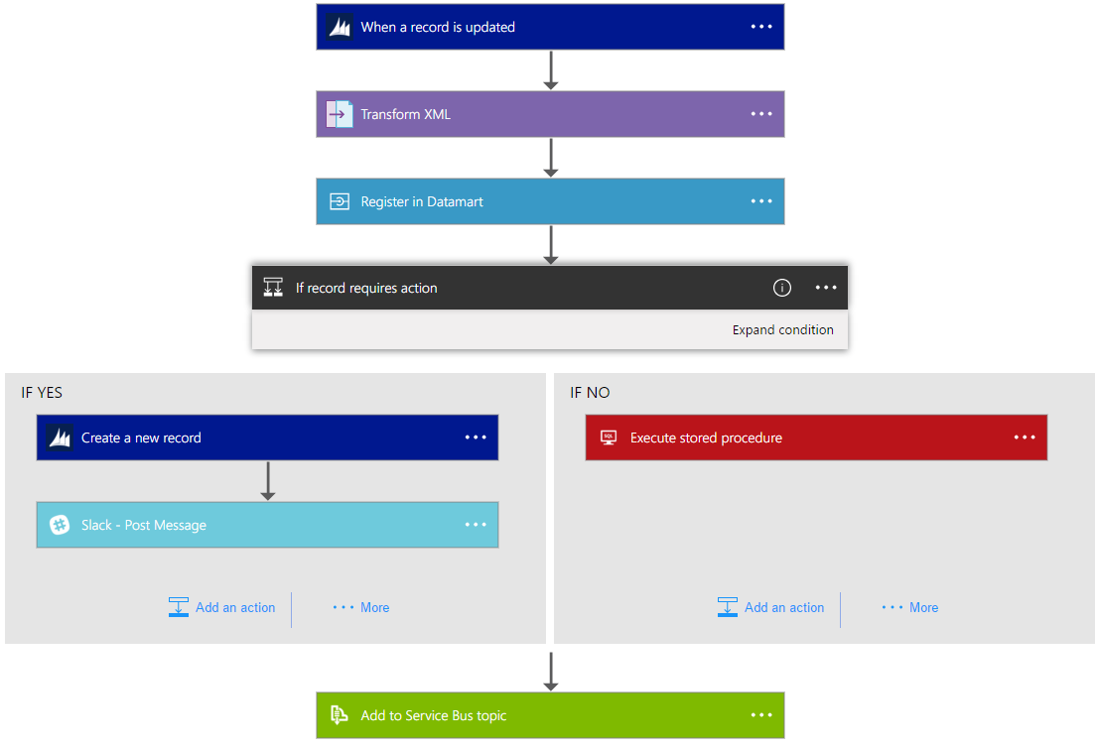
Logic Apps Workflow Designer
Workflow in the cloud
Powerful control flow
Connect disparate applications
No code designer for rapid creation
Also works within Visual Studio for added CI/CD

Slide 14
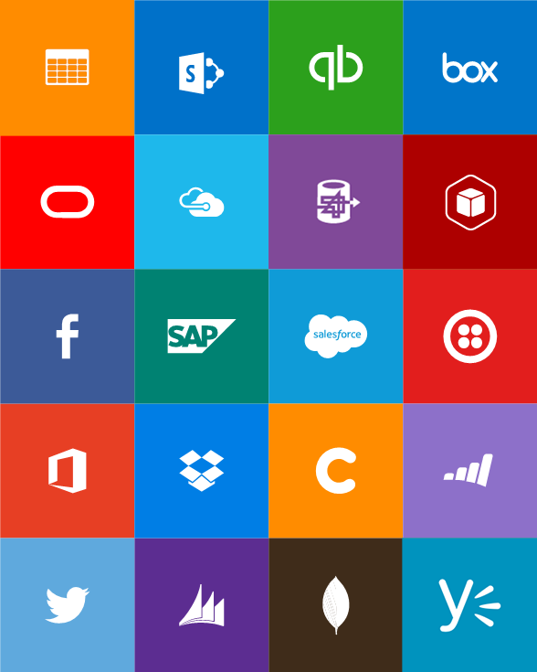

Built-in API Connectors
SaaS
Hybrid
Box
Chatter
Delay
Dropbox
Azure HD Insight
Slack
Azure Media Services
OneDrive
SharePoint
SQL Azure
Office 365
QuickBooks
SalesForce
Sugar CRM
Dynamics CRM
Azure Service Bus
Azure Storage
Timer / Recurrence
Twilio
Twitter
Azure Web Jobs
Yammer
IBM DB2
Informix
Websphere MQ
SQL Server
SharePoint Server
Oracle
SAP
Hybrid Connectivity
BizTalk Messaging & B2B
Protocols
Batching / Debatching
Validate
Extract (XPath)
Transform (+Mapper)
Convert (XML-JSON)
Convert (XML-FF)
X12
EDIFACT
AS2
TPM
Rules Engine
Flat file
HTTP, HTTPS
FTP, SFTP
POP3/IMAP
SMTP
File

Slide 15
Event Grid

Slide 16
Azure Event Grid
Fully-managed event routing
Near real-time event delivery at scale
Broad coverage within Azure and beyond
Backbone of event-driven computing
Notes:
If you’ve done any UI work in the past, you might be familiar with delegates and event-driven programming. This has been a solved problem for a long time within application, now it is finally coming to the cloud.

Slide 17


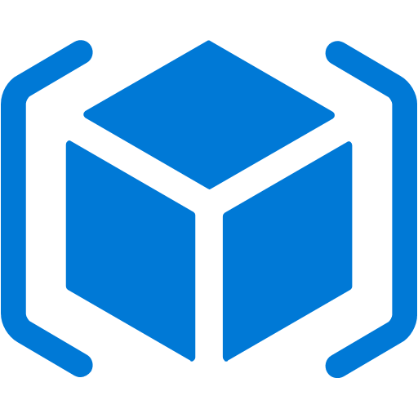

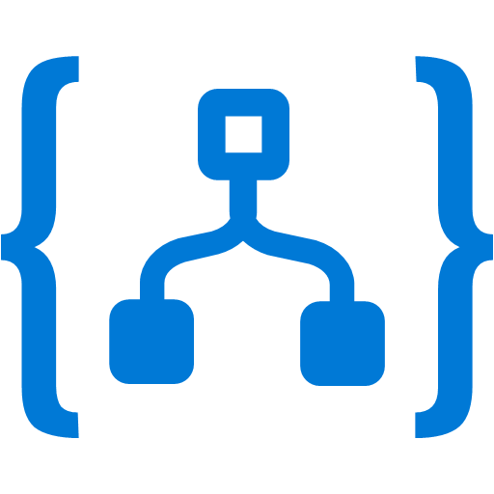


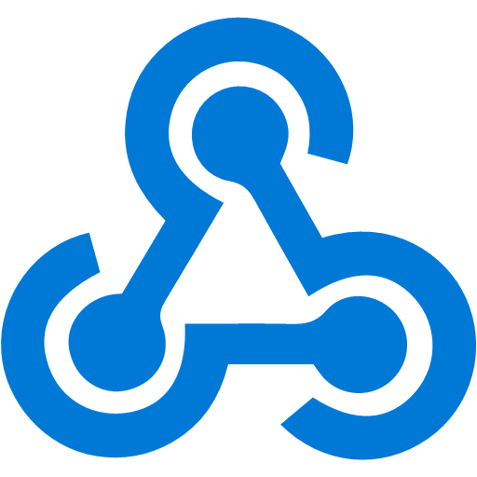

Manage all events in one place
Event publishers
Event handlers
Blob Storage
Azure Functions
Resource Groups
Logic Apps
Azure Subscriptions
Azure Automation
Event Hubs
WebHooks
Custom Events
Notes:
It comes down to having a collection of event publishers and event handlers.

Slide 18
Cosmos DB

Slide 19
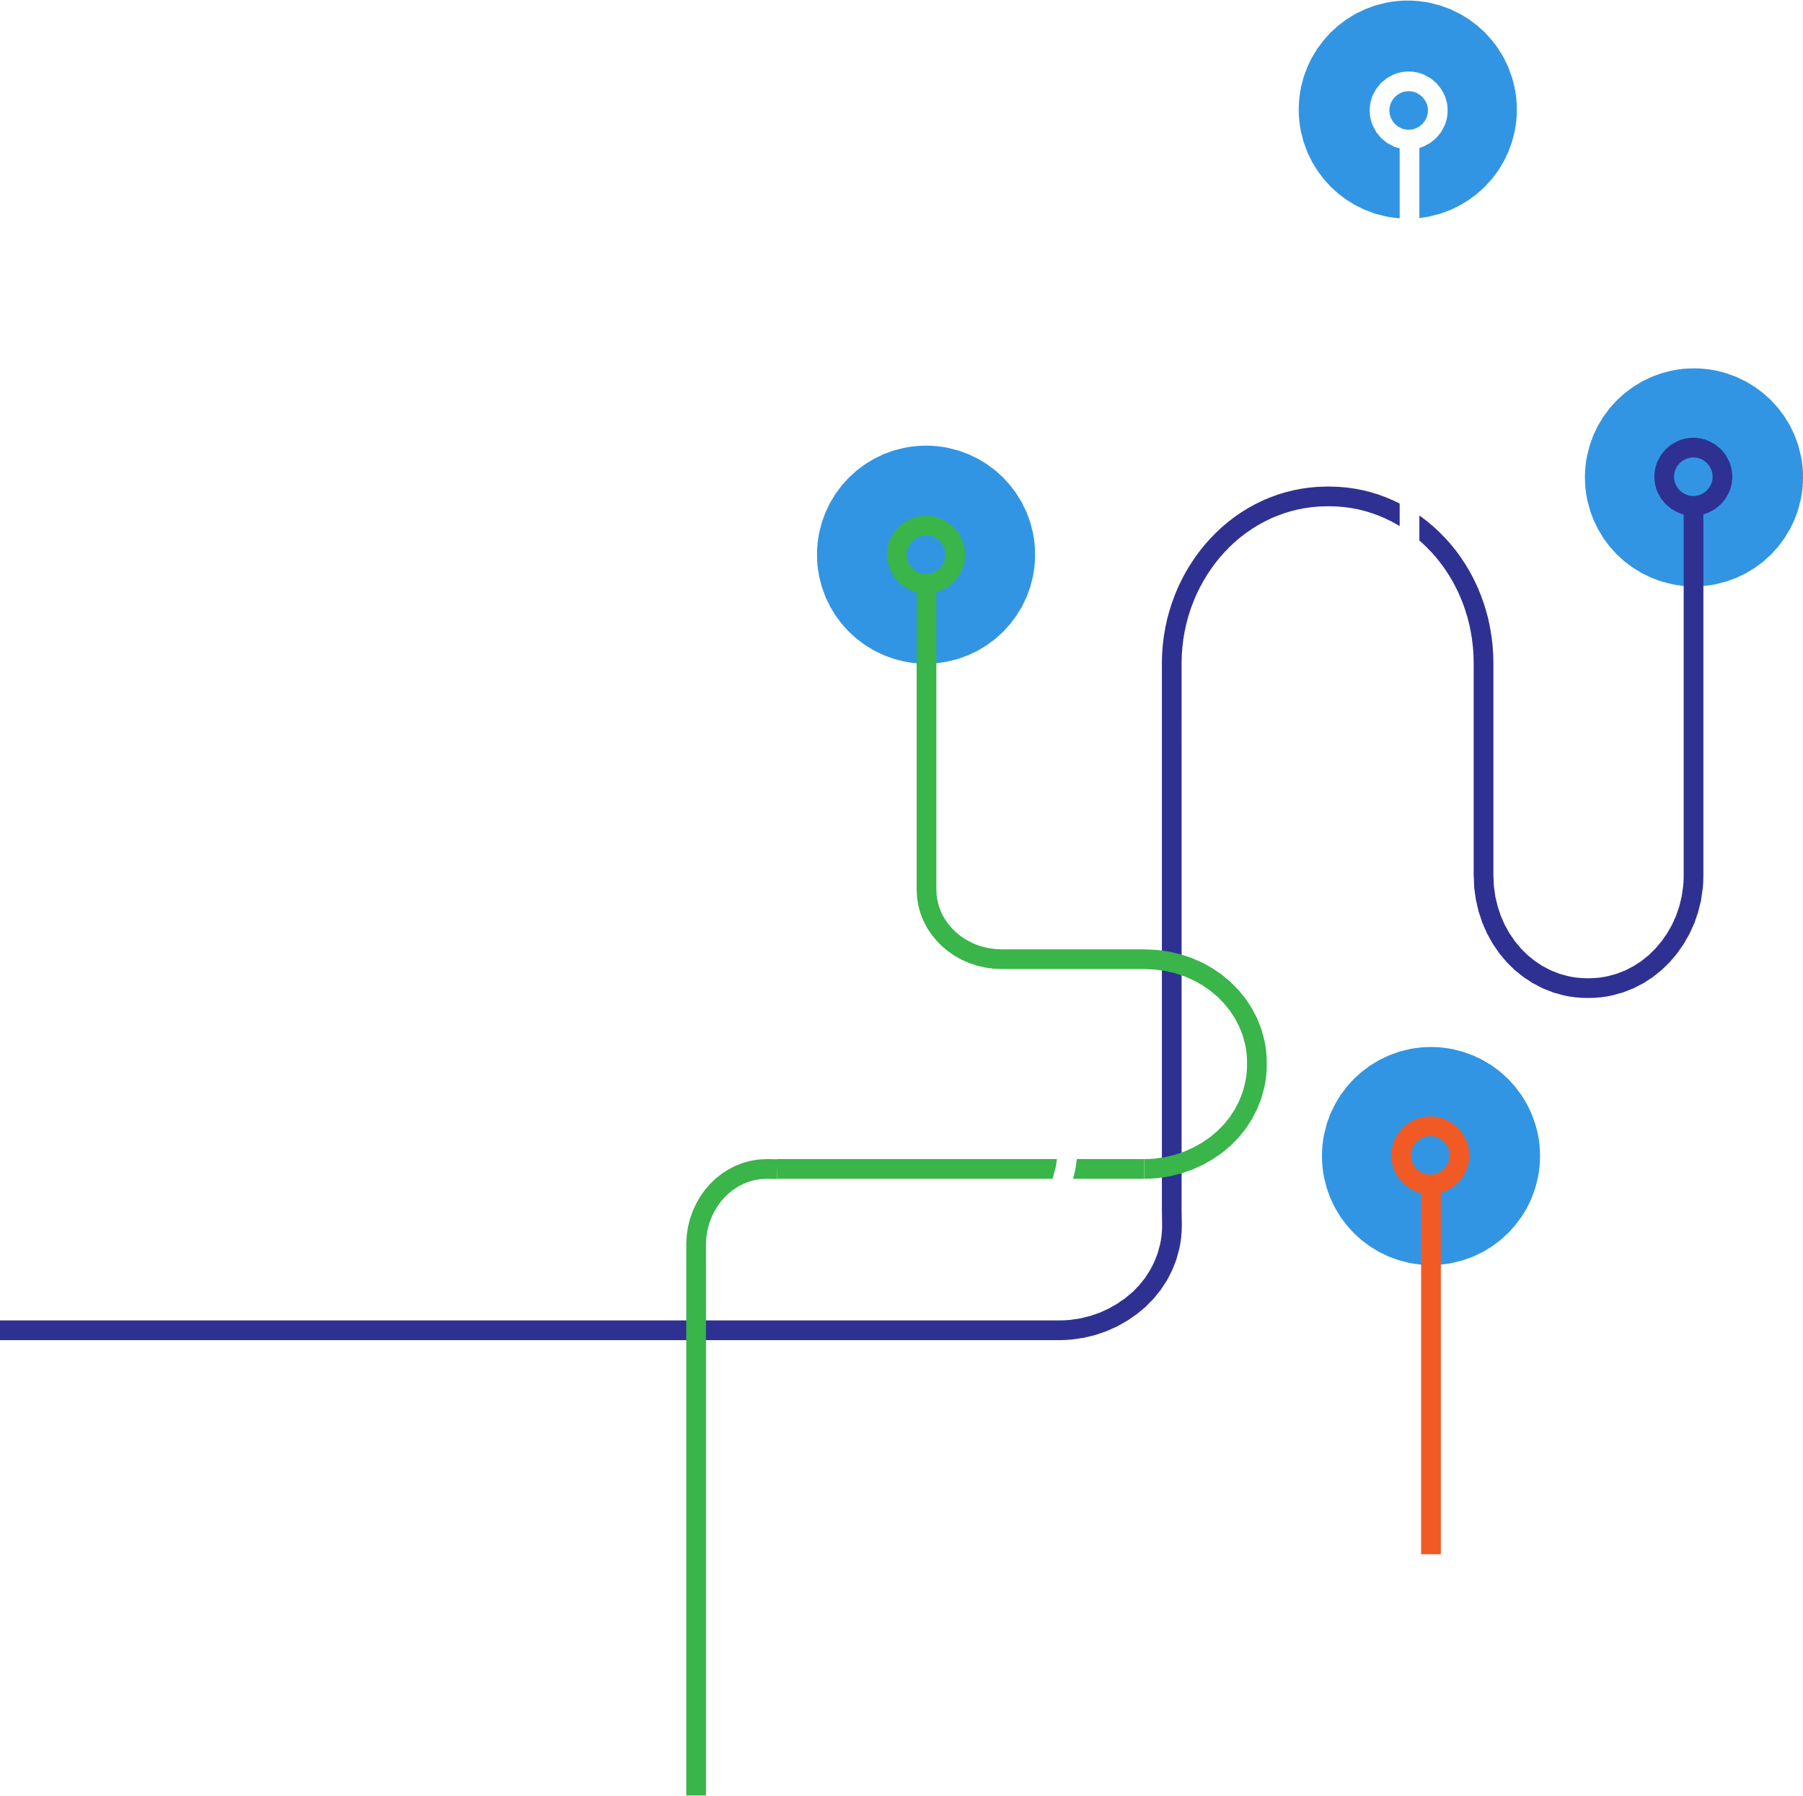
Azure Cosmos DB
Multi-model and multi-API
DATA MODEL
APIs
Key-value
Document
Graph
…
SQL (DocumentDB)
MongoDB
Tables
Gremlin Graph
..

Slide 20
Azure Cosmos DB
Globally-distribute data around the world
Turn-key global distribution
Automatically replicate all your data around the world – across more regions than Amazon and Google combined

Slide 21
API Management Gateway

Slide 22

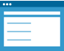

AZURE API
MANAGEMENT
APP DEVELOPERS
Developer Portal
DIRECT OR
VPN
BACKEND
SERVICES
APPS
Gateway
Hosted anywhere.
Developed using any technology.
API PUBLISHERS
Publisher portal

Slide 23
Azure API Management
API Management
Facade
decouple
modernize
optimize
Middleware
protect
cache
log
Monitoring
usage
health
monetization
DX
discover
document
on-board
Web Apps
Mobile Apps
API Apps
Function Apps
Azure APIs
On-prem APIs
3rd party APIs
Azure App Service

Slide 24
Plan + Track
Release
Development
Production
Develop + Test
Monitor + Learn
Notes:
There is a plethora of great tools out there

Slide 25
Demo

Slide 26
Serverless use cases
IoT and Cloud Edge
Microservices
Single Page Web Applications
Data Integration
Citizen Developer
Cloud Automation
Notes:
Talking Points:
How our customers are using serverless in their organizations

Slide 27
What’s new in Serverless?

Slide 28
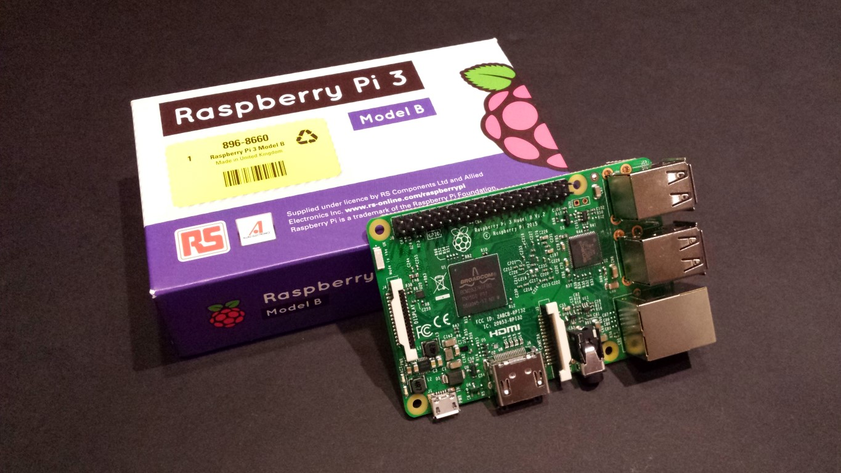
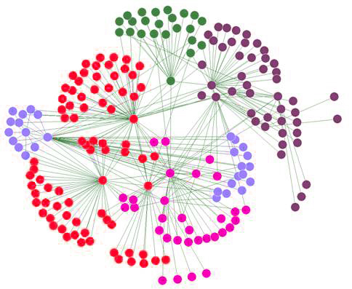
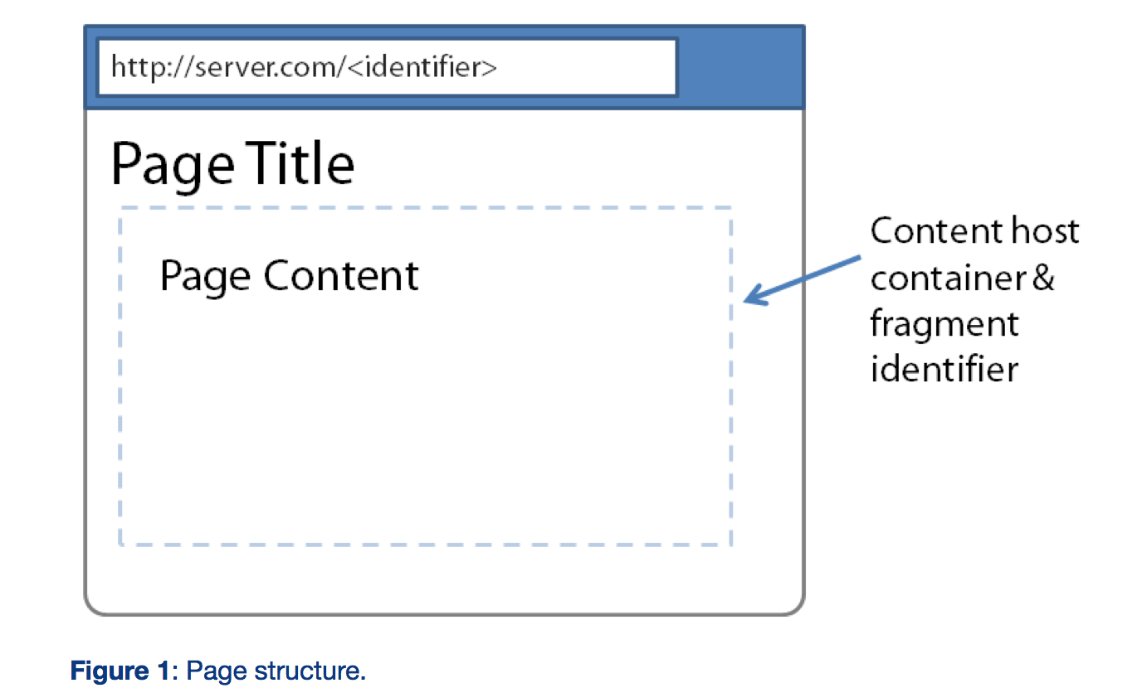
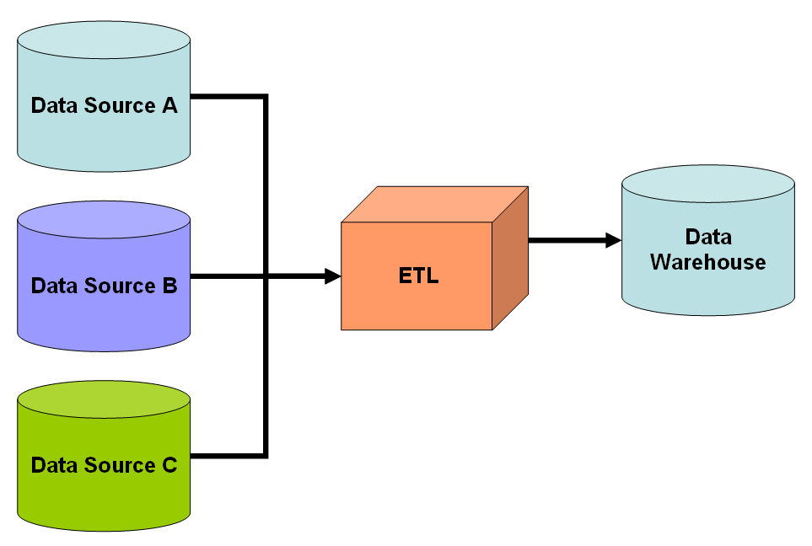
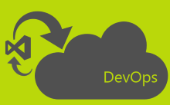
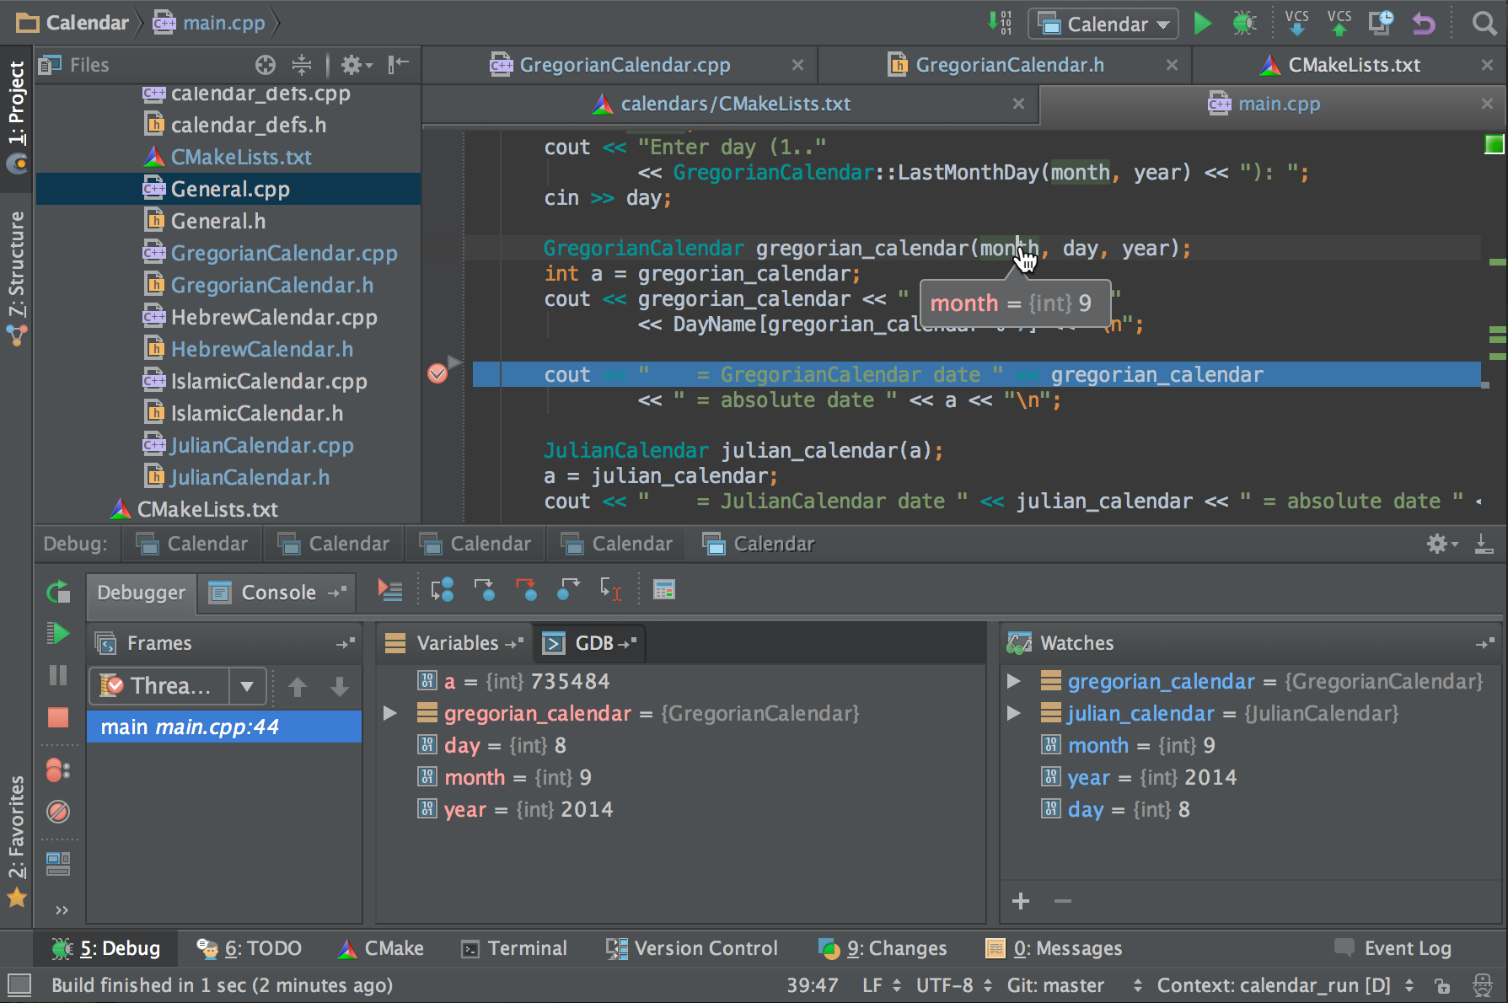
IoT and Cloud Edge
Python Container Preview
Azure IoT Edge
Durable Functions GA
Microservices
Single Page Web Applications
Data Integration
Cloud Automation
Citizen Developer
Notes:
MSFT is making it possible to run some of the serverless platform in containers. This is a huge enabler in the IoT and Cloud Edge space. For example, you can run machine learning models or Azure functions that validate device data right on the device itself.

Slide 29
IoT and Cloud Edge
Microservices
Durable Functions GA
Durable Functions Node.js Preview
Single Page Web Applications
Data Integration
Cloud Automation
Citizen Developer
Notes:
Talking Points:
Orchestrator Function: used to orchestrate “activity functions”. Sort of like logic apps.
Function Chaining (serial)
Fan Out/Fan In
Async HTTP APIs: endpoints let us know how our async process is running
Monitoring: functions that can change the process based on data received from monitor (e.g. what if job fails).
Long Running Transactions: human interaction where I can change states on process that I wake up many days later if needed.

Slide 30
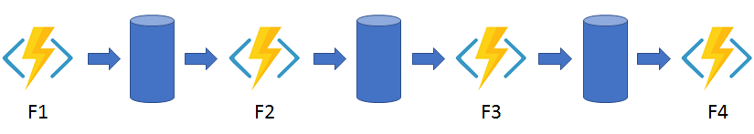
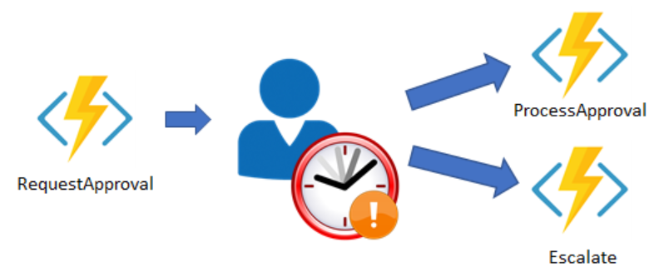
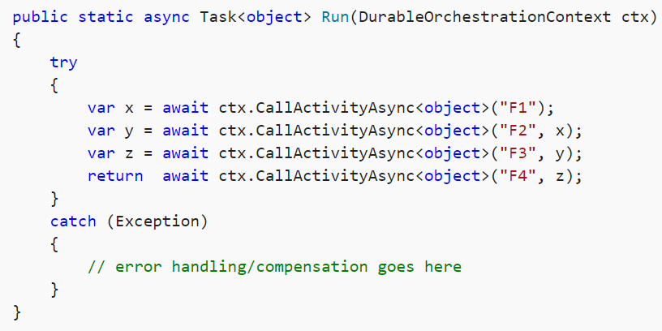
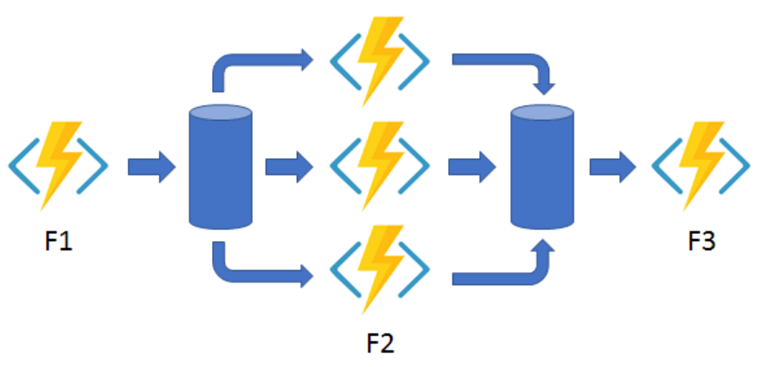
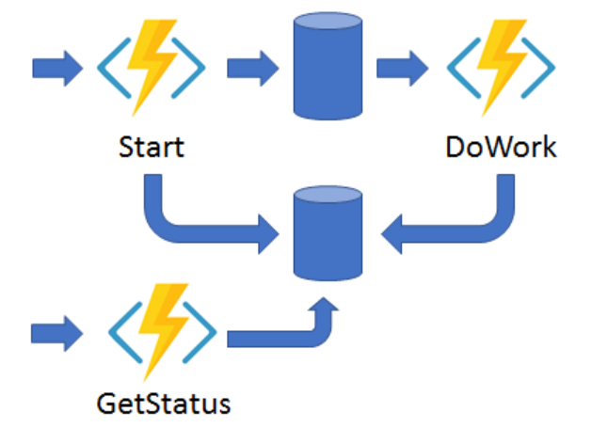
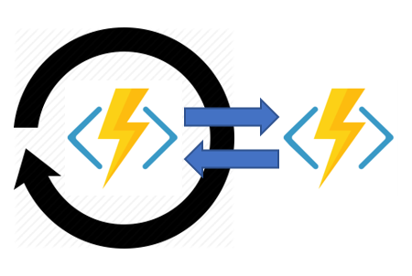
Solving practical problems
Function Chaining
Long running transaction
Fan Out / Fan In
Monitoring
Async HTTP APIs
Notes:
Talking Points:
Orchestrator Function: used to orchestrate “activity functions”. Sort of like logic apps.
Function Chaining (serial)
Fan Out/Fan In
Async HTTP APIs: endpoints let us know how our async process is running
Monitoring: functions that can change the process based on data received from monitor (e.g. what if job fails).
Long Running Transactions: human interaction where I can change states on process that I wake up many days later if needed.

Slide 31
IoT and Cloud Edge
Microservices
Single Page Web Applications
Data Integration
Logic Apps and Event Grid Integration
CloudEvents 1st class support
Cloud Automation
Citizen Developer
Notes:
Talking points:
Event Grid supporting CloudEvents specification
Create events off the storage account and wire up to logic apps or functions.

Slide 32
IoT and Cloud Edge
Microservices
Single Page Web Applications
Data Integration
Citizen Developer
Cloud Automation
Notes:
MSFT is making it possible to run some of the serverless platform in containers. This is a huge enabler in the IoT and Cloud Edge space. For example, you can run machine learning models or Azure functions that validate device data right on the device itself.

Slide 33
Why people love Serverless
No infrastructure deployment
Simplified Scale
Simple Programming Model
Notes:
Talking Points:
Focus on maintaining code, maintaining app instead of environment
Don’t have to worry about scaling, if you understand how serverless platforms work, you can write it correctly so that it scales infinitely for your needs
Tools and frameworks to make development and deployment easy.

Slide 34
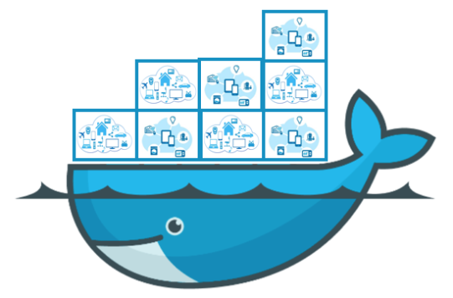
Serverless vs. FaaS
“FaaS”
f(x)
Event-driven, functional programming
“Container as a Service”
“Serverless Containers”
Abstraction of servers
Instant Scale
Micro-billing
Serverless Infrastructure
Notes:
Talking Points:
Strict definition of serverless is:
Abstraction of infra
Scale instantly
Pay only for the time your application executes
In our industry, what we are seeing now is people shipping FaaS (Functions as a Service) that is running on this serverless infrastructure. Emerging are things like Azure Container Instances which allow organizations to take containers and run on the platform with the same rules (no orchestrator, vms).

Slide 35
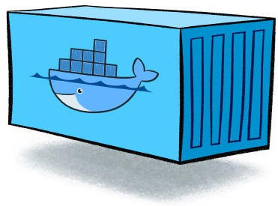

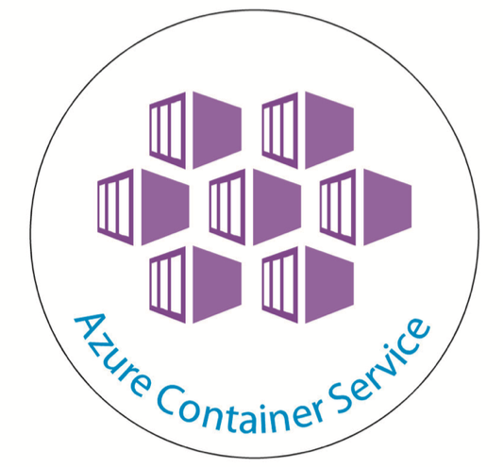
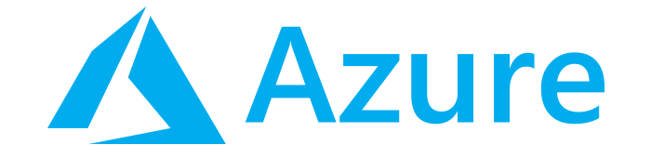
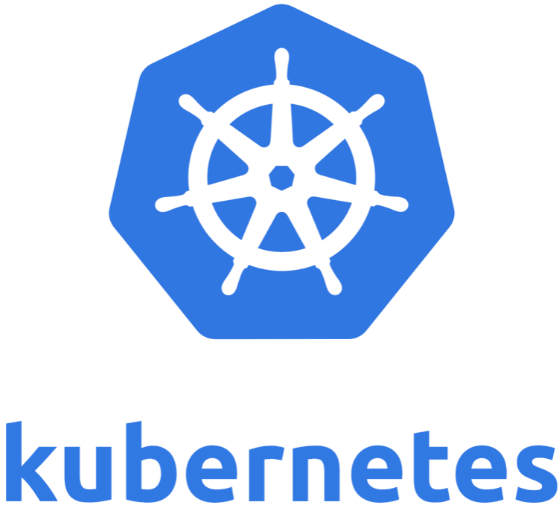
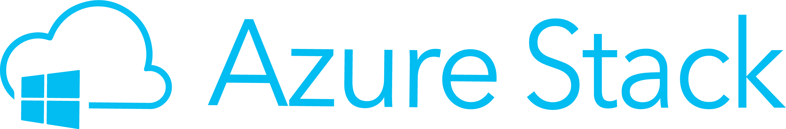
Serverless vs. FaaS
“FaaS”
f(x)
Event-driven, functional programming
IaaS / PaaS / On Prem
Notes:
Talking Points:
By product of this emergence, is the capability to run the same functions on other infrastructure.

Slide 36
Questions?

Slide 37
Thank you!

